Slide 1
CONCRETE TECHNOLOGY
Chapter No:2 Properties of Aggregates
DEPARTMENT OF CIVIL ENGINEERING

Slide 2
SYLLABUS
2.1 Properties of fine aggregates :
Concept of size, shape, surface texture, strength , specific gravity, bulk density , water absorption surface moisture, soundness, bulking impurities.
2.2 Determination of fineness modulus & grading zone of sand by sieve analysis, determination of silt content in sand & their specification as per IS 383
2.3 Bulking of sand, phenomenon of bulking, its effect on concrete mix proportion.

Slide 3
2.4 Properties of coars aggregates :
Concept of size, shape, surface texture, water absorption, soundness, specific gravity & bulk density
2.5 Determination of fineness modulus of coarse aggregate by sieve analysis, grading of Coarse Aggregates.
2.6 Determination of crushing value, impact value & abrasion value of coarse aggregate, flakiness index & elongation index of coarse aggregate and their specification.

Slide 4
LEARING OBJECTIVES
About 70% to 80% of volume of concrete is composed of aggregate hence the properties of concrete are greatly affected by properties of aggregates. Concrete in plastic stage can be considered in two system
(a) paste
(b) Aggregate
Hence it is important to study the properties of aggregates.

Slide 5
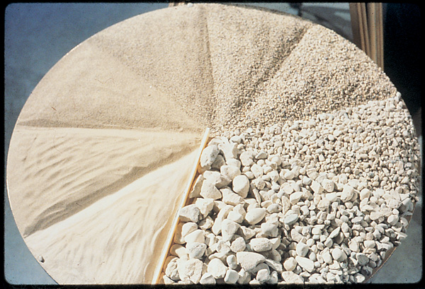
AGGREGATES : Aggregates are inert materials such as sand , gravel or crushed stones etc. , which are used in concrete to produce shrinkage & cost of aggregate.

Slide 6
SOURCES OF AGGREGATES :
Igneous rocks : Hard, tough & dense. Granite , Basalt.
Sedimentary rocks : Lime stone make good aggregate.
Metamorphic rocks : Slate, gneiss , marble, make good aggregate.
(Acquired properties equally important apart from source)

Slide 7
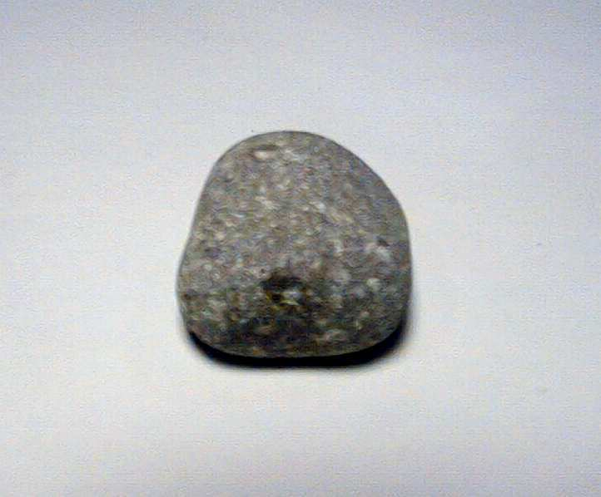
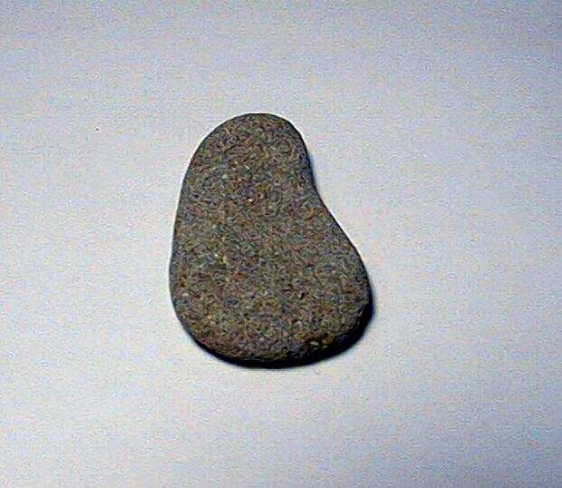
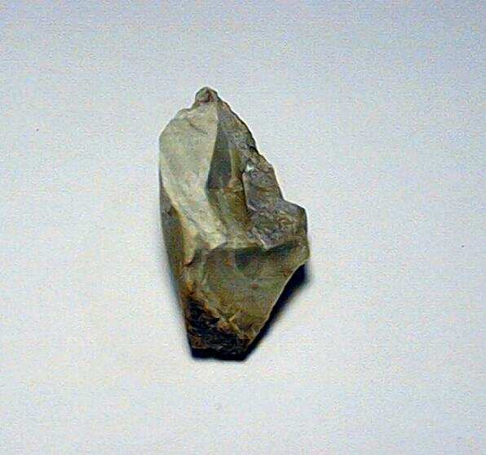
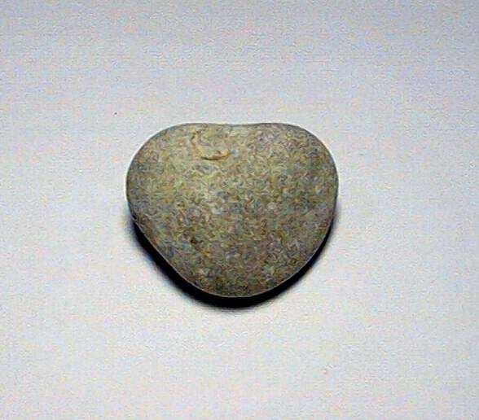
SHAPE :It affects – workability & strength of
concrete
AUGULAR ROUND
ELONGATED
FLAT

Slide 8
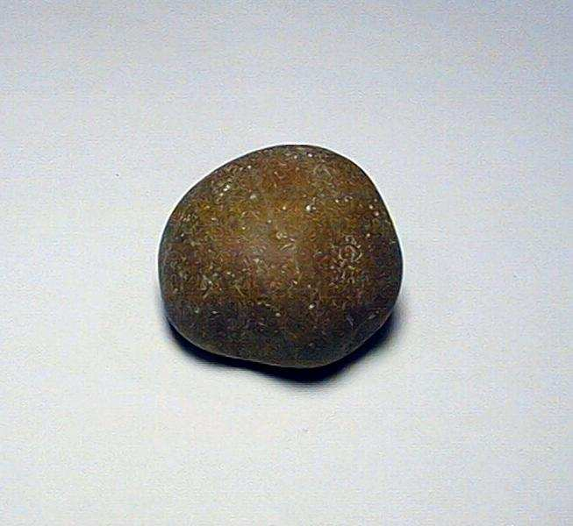
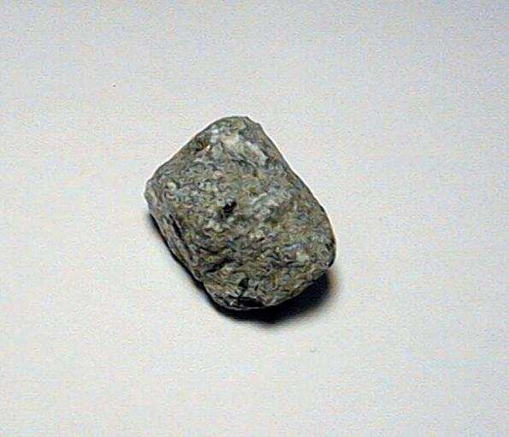
Texture : It defines the surface of aggregates
Smooth – Requires less cement
– Permits denser packing
– Permits better workability
Rough – High bond strength
_Requires less cement
Max Agg. Size should be as large as possible to reduce water demand. But

Slide 9
WATER ABSORPTION
Bone dry aggregates absorbs certain amount of water. It affects
Workability
W/C ratio
Durability
Bone Dry- When internal pores are all dry.
Air Dry- When some of the pores are dry.
Saturated Surface Dry (SSD)- When all the pores are filled.
Saturated-When all the pores are filled & if water is also sticking on surface

Slide 10
POROSITY
-It affects durability as it is harmful under conditions of alternate freezing and thawing.
MOISTURE CONDITION OF AGGREGATES

Slide 11
BULK DENSITY & SPECIFIC GRAVITY
Bulk density in loose state is directly proportional to sp. Gravity of aggregate and angularity
Bulk density = wt. of agg. in cylinder
volume of cylinder.
Sp. Gravity for rock should be 2.6 to 2.8

Slide 12
AGG. CRUSHING VALUE (ACV) :
Agg dried in oven at 100-110⁰C for 3-4 hrs.
Filled up to 10 cm in 3 layers in cylinder by 25 stroke of tamping rod (wt. Of sample = A)
Surface is leveled & then crushing load of 40 T applied in 10 minutes
Sieved on 2.36 mm IS sieve
Fraction passing the sieve = B
ACV = B/A x 100
ACV < 30% for roads and pavements
< 45% for other structures.
Agg. passing 12.5 mm & retained over 10 mm IS sieve taken for test.

Slide 13
IMPORTANCE OF GRADATION
Gradation affects :
Workability
Finishing characteristics of fresh concrete
Void in the concrete
Strength of concrete
Good grading : It contains all standard fractions of aggregate in required proportions.

Slide 14
FINESS MODULUS (FM)
FM is an empirical factor obtained by adding cumulative % ages of agg. retained on each sieve and dividing by 100.
Larger the factor coarser the aggregate
Fine sand FM 2.2 – 2.6
Medium sand FM 2.6 – 2.9
Coarse sand FM 2.9 – 3.2
FM more than 3.2 considered unsuitable for concrete

Slide 15
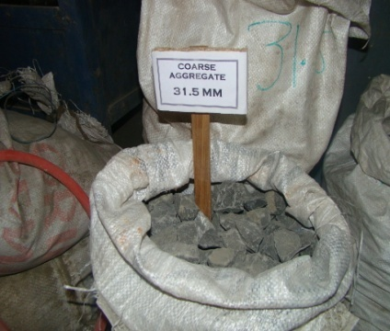
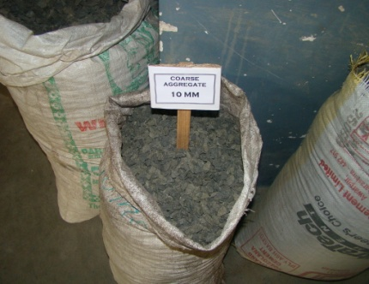
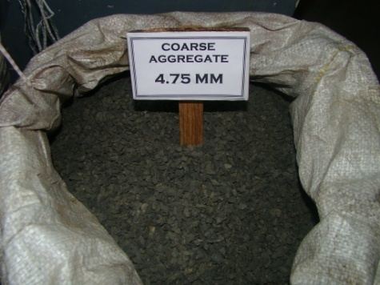
Different sizes of fine aggregate

Slide 16
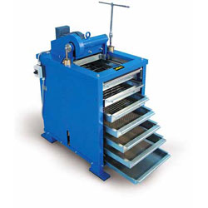
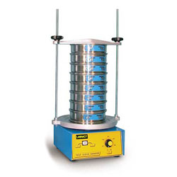
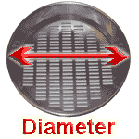
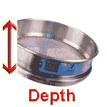
Sieve shaker

Slide 17
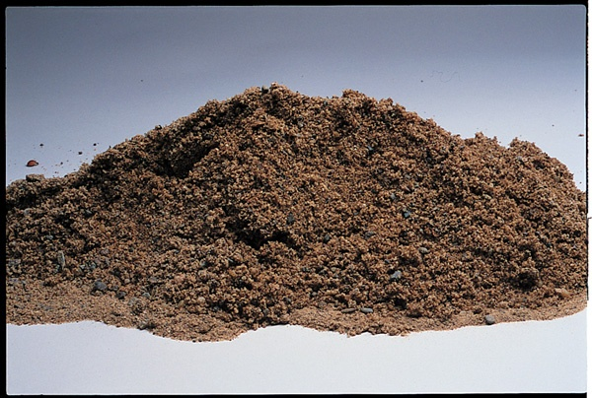
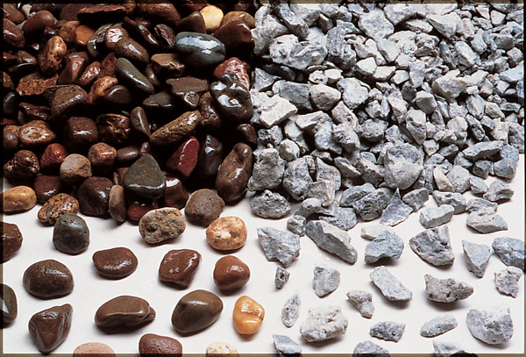
FINE AGGREGATES
Sand and/or crushed stone
< 5 mm
F.A. content usually 35% to 45%
by mass or volume of total aggregate
COARSE AGGREGATES
Gravel and crushed stone
≥ 5 mm
typically between 9.5 and 37.5 mm

Slide 18
Fineness Modulus
Sieve | Wt Retained (gm) | Cumu. Wt (gms) | Cumu. Wt %
4.75 mm | 10 | 10 | 2
2.36 mm | 50 | 60 | 12
1.18 mm | 50 | 110 | 22
600  | 95 | 205 | 41
300  | 175 | 380 | 76
150  | 85 | 465 | 93
Dust | 35 | 500 | -
 | 500 |  | 246
 | Fineness | 246/100 = | 2.46

Slide 19
CLASSIFICATION OF FINE AGGREGATE
Is sieve designation | Percentage passing for
 | Grading zone I | Grading Zone II | Grading Zone III | Grading Zone IV
10 mm | 100 | 100 | 100 | 100
4.75 MM | 90-100 | 90-100 | 90-100 | 95-100
2.36MM | 60-95 | 75-100 | 85-100 | 95-100
1.18 MM | 30-70 | 55-90 | 75-100 | 90-100
600 micron | 15-34 | 35-59 | 60-79 | 80-100
300 micron | 5-20 | 8-30 | 12-40 | 15-50
150 micron | 0-10 | 0.10 | 0.10 | 0-15

Slide 20
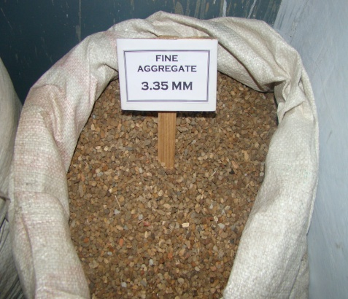
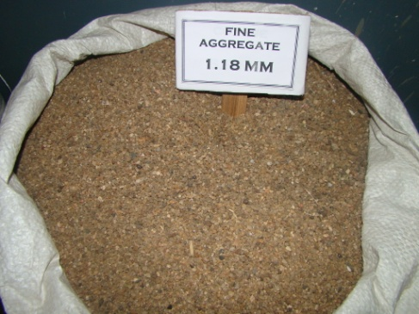
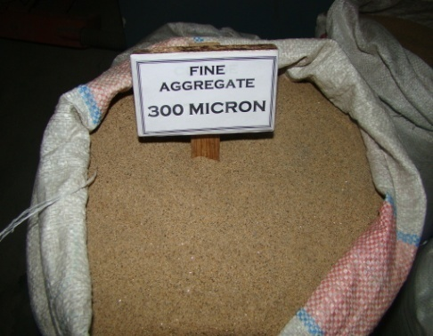
Different sizes of fine aggregate

Slide 21
Grading of Aggregates
Grading is the particle-size distribution of an aggregate as determined by a sieve analysis using wire mesh sieves with square openings.
ASTM C 33
Fine aggregate―7 standard sieves with openings from 150 μm to 9.5 mm
Coarse aggregate―13 sieves with openings from 1.18 mm to 100 mm
The material is sieved through a series of sieves that are placed one above the other in order of size with the largest sieve at the top.
Dry agg. is sieved to prevent lumps.

Slide 22
Agg.
*****
#4
#8
#16
#30
#50
#100
Pan
Sieve shaker
Lateral & Vertical motion

Slide 23
Determination of the Grading of Aggregate
There are two different methods for determining the agg. grading:
Fineness Modulus (FM)
Granulometry
Fineness Modulus (FM):
FM is a single figure which is the sum of cumulative % retained on a series of sieves having a clear opening half that of the preceeding one. Usually determined for fine agg.
FM =
Σ (% cumulative retained on each sieve)
100

Slide 24
Ex:A 500gr sample of a Fine Agg. was sieved. Determine FM?
FM= 6+22+42+66+91+98 = 3.25
100
Sieve | Amount Retained on (gr) | Amount Retained on (%) | % Cumulative Retained on
3/8" | 0 | 0 | 0
#4 | 30 | 6 | 6
#8 | 80 | 16 | 22
#16 | 100 | 20 | 42
#30 | 120 | 24 | 66
#50 | 125 | 25 | 91
#100 | 35 | 7 | 98
Pan | 10 | 2 | 100

Slide 25
A good aggregate gradation for a particular concrete is the one that leads to a workable, dense & uniform concrete, without any segregation of particles.

Slide 26
SPECIFIC GRAVITY
Specific gravity is the ratio of the weight on a unit volume of material to the weight of the same volume of water at 20º to 25ºC

Slide 27
SPECIFIC GRAVITY OF AGG.
Weight of Agg. (W_{A}
Weight of an equal volume of water (V_{A}*ρ_{w})
ρ_{A}
Density of Agg.
Sp.Gr.=
W_{A}
=
V_{A}*ρ_{w}
ρ_{w}
Density of Water

Slide 28
Bulking of Sand
Bulking of Sand
Means ‘increase in
Its volume due to
Presence of surface
Moisture.

Slide 29
TESTING OF AGGREGATE
ABRASION RESISTANCE :
Especially when concrete is used in roads or floor surfaces subjected to heavy traffic load.
Hardness, or resistance to wear (abrasion) is determined by Los-Angeles abrasion test.

Slide 30
Los Angeles Abrasion Test:
The agg with a specified grading is placed inside the L.A. Testing Machine
Loose steel balls are placed inside the drum
The apparatus is rotated for a specified cycles
Finally the loss in weight is determined. by screening with #12 sieve.
Resistant → <10% for 100 revolutions
→ <50% for 500 revolutions

Slide 31
AGG ABRASION VALUE TEST :
Machine : Los Angeles
Grading of Aggregate – given in table
Abrasive charge & wt. of sample – in table
‘Wt A’ of cleaned and over dried sample taken
Machine rotated @ 30- 33 rev/min
No. of revolution
= 500 (for A, B, C & D samples)
= 1000 (for E, F & G )

Slide 32
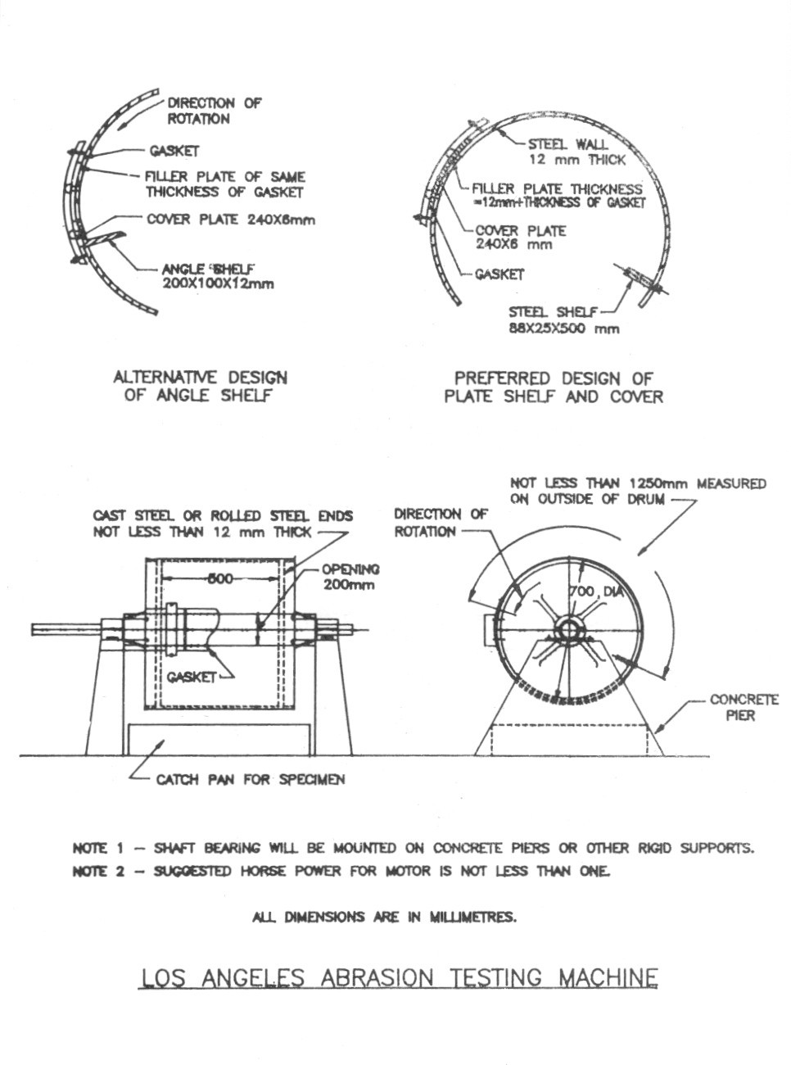
After revolutions :
Material finer than 1.7 mm separated by sieving
Coarse portion washed & dried in oven at 105-110 ⁰ C
Weight of dried portion = B (retained)
Abrasion value =
AV < 30% for Pavement works
< 50% for other works

Slide 33
Aggregate Impact Value Test :
It is measured by performing agg. Impact test which is done in laboratory as follows.
Sample of agg. Passing 12.5mm IS sieve & retained on 10 mm IS sieve is oven dried.
Fill this aggregate into cylindrical cup in three layers and tamp 25 times each, and level off.
The net weight of aggregate is taken to nearest gram (W1).

Slide 34
The hammer is allowed to fall freely on aggregate from height, 15 such blows are given.
Crushed aggregate is removed fro the cup and sieved on 2.36 mm IS sieve.
The fraction passing is weighed to nearest 0.1 gm. (W2).
Aggregate impact value = W2 x 100
W1
expressed as percentage.

Slide 35
Summary :
Cement Concrete looks simple but actually it is very complex material . It is prepared at site hence, it varies in great extent depending upon the quality of the ingredients i.e cement, aggregate, & water quality of workmanship etc . For making a good concrete we must have a good knowlegde of it , so which we have studied in this chapter.

Slide 36
References:
CONCRETE TECHNOLOGY BY M. L. Gambhir
CONCRETE TECHNOLOGY BY A. M. Neville & J J Brooks
CONCRETE TECHNOLOGY BY M. S. Shetty D. Kulkarni
CONCRETE TECHNOLOGY BY H. R. Rixom

